Slide 1
>cbind(mow, unmow)
mow unmow
[1,] 12 8
[2,] 15 9
[3,] 17 7
[4,] 11 9
[5,] 15 NA
> rbind(mow,unmow)
[,1] [,2] [,3] [,4] [,5]
mow 12 15 17 11 15
unmow 8 9 7 9 NA
> rich
[1] 12 15 17 11 15 8 9 7 9
> length(rich) = 10
> rich
[1] 12 15 17 11 15 8 9 7 9 NA

Slide 2
>rich<-c(12,15,17,11,15,8,9,7,9) > Rich [1] 12 15 17 11 15 8 9 7 9 > graze<-c(rep("mow",5),rep("unmow",4)) > graze [1] "mow" "mow" "mow" "mow" "mow" "unmow" "unmow“ [8] "unmow" "unmow“ > grass.df = data.frame(rich, graze) > grass.df rich graze 12 mow 15 mow 17 mow 11 mow 15 mow 8 unmow 9 unmow 7 unmow 9 unmow

Slide 3
str(grass.df)
'data.frame': 9 obs. of 2 variables:
$ rich : num 12 15 17 11 15 8 9 7 9
$ graze: Factor w/ 2 levels "mow","unmow": 1 1 1 1 1 2 2 2 2
> graze.f = factor(graze)
>graze.f
[1] mow mow mow mow mow unmow unmow unmow unmow
Levels: mow unmow

Slide 4
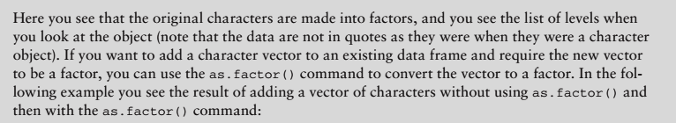

Slide 5
To add a character vector to an existing data frame and require the new vector to be a factor > grass.df$graze2 = graze
>grass.df
rich graze graze2 1 12 mow mow 2 15 mow mow 3 17 mow mow 4 11 mow mow 5 15 mow mow 6 8 unmow unmow 7 9 unmow unmow 8 7 unmow unmow 9 9 unmow unmow > str(grass.df) 'data.frame': 9 obs. of 3 variables: $ rich : int 12 15 17 11 15 8 9 7 9 $ graze : Factor w/ 2 levels "mow","unmow": 1 1 1 1 1 2 2 2 2 $ graze2: chr "mow" "mow" "mow" "mow" ...

Slide 6
>grass.df$graze2 = as.factor(graze) > str(grass.df) 'data.frame': 9 obs. of 3 variables: $ rich : int 12 15 17 11 15 8 9 7 9 $ graze : Factor w/ 2 levels "mow","unmow": 1 1 1 1 1 2 2 2 2 $ graze2: Factor w/ 2 levels "mow","unmow": 1 1 1 1 1 2 2 2 2

Slide 7
Packages
>search() [1] ".GlobalEnv" "tools:RGUI" "package:stats" "package:graphics" [5] "package:grDevices" "package:utils" "package:datasets" "package:methods" [9] "Autoloads" "package:base
>installed.packages() >install.packages(‘gdata’)
# Installing
install.packages("readr")
# Loading
library("readr")

Slide 8
Using the Clipboard to Make Data
> our.data = scan()
1: 1
2: 2
3: 3
4: 4
5: 5
6:
Read 5 items
>our.data
[1] 1 2 3 4 5
> day2 = scan(what = 'character')
1: hi
2: hello fry
4: tryme
5:
Read 4 items
>day2
[1] "hi" "hello" "fry" "tryme"

Slide 9
>data4 = scan(sep = ',')
1: 23,17,12.5,11,17,12,14.5,9
9: 11,9,12.5,14.5,17,8,21
16:
Read 15 items
>data4
[1] 23.0 17.0 12.5 11.0 17.0 12.0 14.5 9.0 11.0 9.0 12.5 [12] 14.5 17.0 8.0 21.0
>data5 = scan(sep = ',', what = 'char')
1: hi hello ram sir
2: i am learning R
3:
Read 2 items
>data5 [1]
[1]"hi hello ram sir" "i am learning R"

Slide 10
Reading a File of Data from a Disk
data6 = scan(file = 'int.txt')
Read 15 items
data6 [1]
[1] 23.0 17.0 12.5 11.0 17.0 12.0 14.5 9.0 11.0 9.0 12.5
[12] 14.5 17.0 8.0 21.0
getwd()
setwd('pathname')
dir()
list.files()

Slide 11
to select a fle
data7 = scan(file.choose())
Read 15 items
> data7
[1] 23.0 17.0 12.5 11.0 17.0 12.0 14.5 9.0 11.0 9.0 12.5
[12] 14.5 17.0 8.0 21.0
> data8 = scan(file.choose(), what = 'char', sep = ',') Read 12 items > data8 [1] "Jan" "Feb" "Mar" "Apr" "May" "Jun" "Jul" "Aug" "Sep" "Oct" "Nov" "Dec"

Slide 12
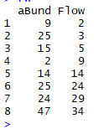
Reading Bigger data Files
> fw = read.csv(file.choose())
Fw
>my.ssv = read.table(file.choose(), header = TRUE)
>my.ssv

Slide 13
# Read tabular data into R
read.table(file, header = FALSE, sep = "", dec = ".")
# Read "comma separated value" files (".csv")
read.csv(file, header = TRUE, sep = ",", dec = ".", ...)
# Or use read.csv2: variant used in countries that
# use a comma as decimal point and a semicolon as field separator.
read.csv2(file, header = TRUE, sep = ";", dec = ",", ...)
# Read TAB delimited files
read.delim(file, header = TRUE, sep = "\t", dec = ".", ...)
read.delim2(file, header = TRUE, sep = "\t", dec = ",", ...)
file: the path to the file containing the data to be imported into R.
sep: the field separator character. “\t” is used for tab-delimited file.
header: logical value. If TRUE, read.table() assumes that your file has a header row, so row 1 is the name of each column. If that’s not the case, you can add the argument header = FALSE.
dec: the character used in the file for decimal points.

Slide 14
Reading a local file
To import a local .txt or a .csv file, the syntax
# Read a txt file, named "mtcars.txt"
my_data <- read.delim("mtcars.txt")
# Read a csv file, named "mtcars.csv"
my_data <- read.csv("mtcars.csv")
# Read a txt file
my_data <- read.delim(file.choose())
# Read a csv file
my_data <- read.csv(file.choose())
Reading a file from internet
my_data <- read.delim("http://www.sthda.com/upload/boxplot_format.txt") head(my_data)

Slide 15
Reading lines from a file
read_lines(file, skip = 0, n_max = -1L)
file: file path
skip: Number of lines to skip before reading data
n_max: Numbers of lines to read. If n is -1, all lines in file will be read.
my_file <- system.file("extdata/mtcars.csv", package = "readr")
# Read lines
my_data <- read_lines(my_file)
head(my_data)
# Read whole file
read_file(my_file)

Slide 16
Exporting Data From R
Writing Data From R to txt|csv Files: R Base Functions
R base functions for writing data: write.table(), write.csv(), write.csv2()
Writing data to a file
# Loading mtcars data
data("mtcars")
# Write data to txt file: tab separated values
# sep = "\t"
write.table(mtcars, file = "mtcars.txt", sep = "\t", row.names = TRUE, col.names = NA)
# Write data to csv files:
# decimal point = "." and value separators = comma (",") write.csv(mtcars, file = "mtcars.csv")
# Write data to csv files:
# decimal point = comma (",") and value separators = semicolon (";") write.csv2(mtcars, file = "mtcars.csv")

Slide 17
Fast Writing of Data From R to txt|csv Files: readr package
Installing and loading readr: install.packages(“readr”)
readr functions for writing data: write_tsv(), write_csv()
Writing data to a file
# Loading mtcars data
data("mtcars")
library("readr")
# Writing mtcars data to a tsv file
write_tsv(mtcars, path = "mtcars.txt")
# Writing mtcars data to a csv file
write_csv(mtcars, path = "mtcars.csv")
http://www.sthda.com/english/wiki/import-and-export-data-using-r

Slide 18
Decision Making
Decision making structures require the programmer to specify one or more conditions to be evaluated or tested by the program, along with a statement or statements to be executed if the condition is determined to be true, and optionally, other statements to be executed if the condition is determined to be false.

Slide 19
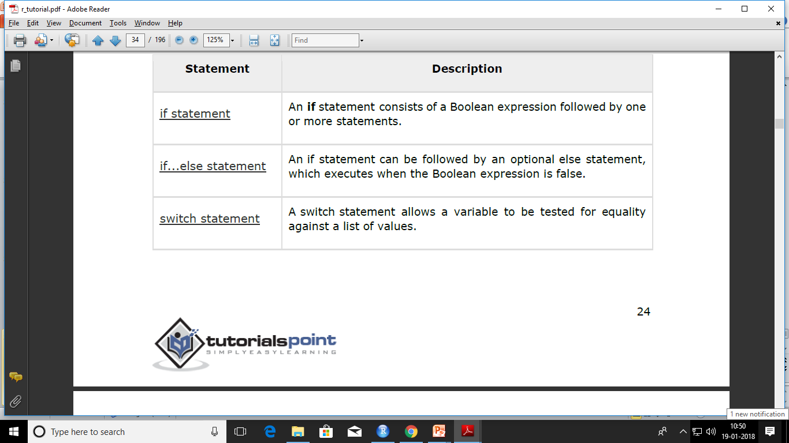

Slide 20
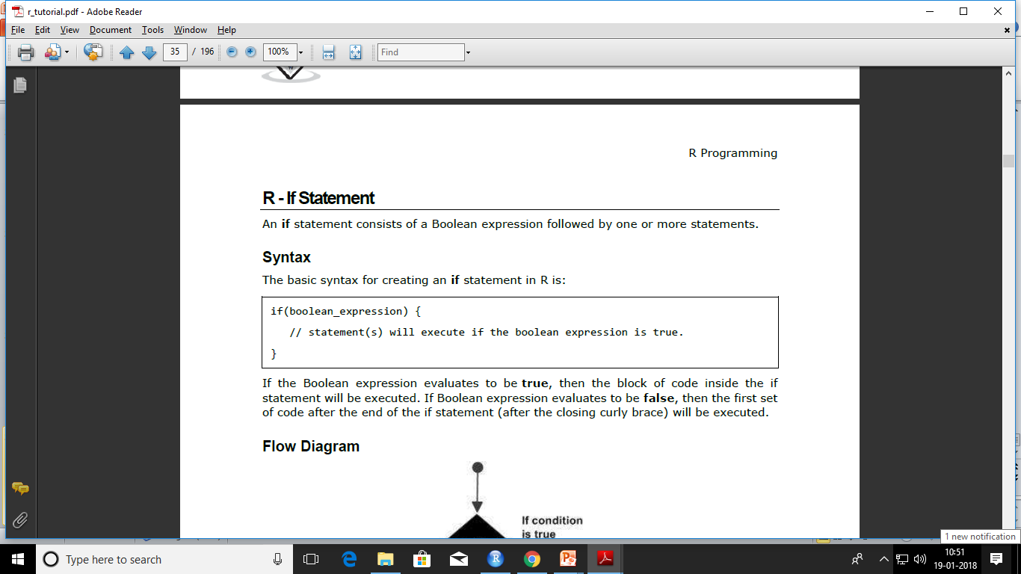

Slide 21
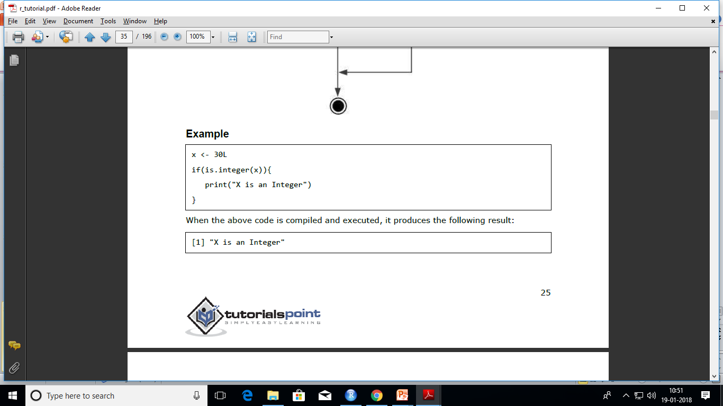

Slide 22
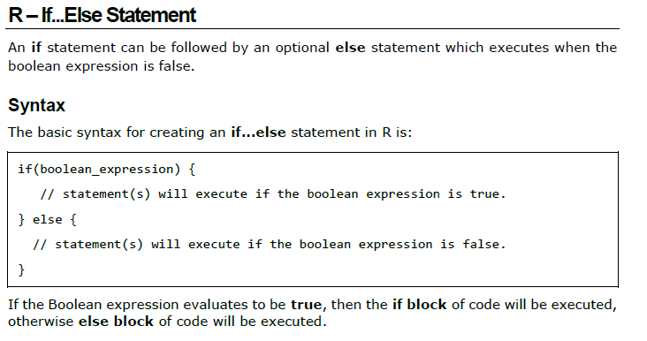

Slide 23
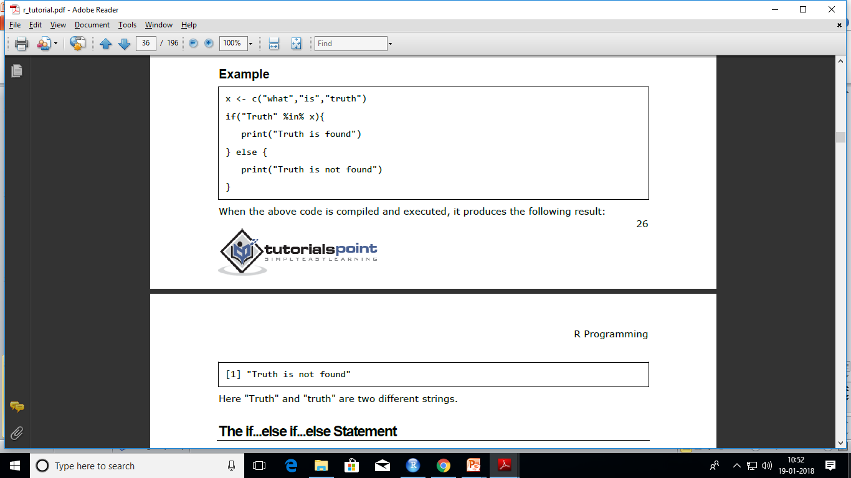

Slide 24
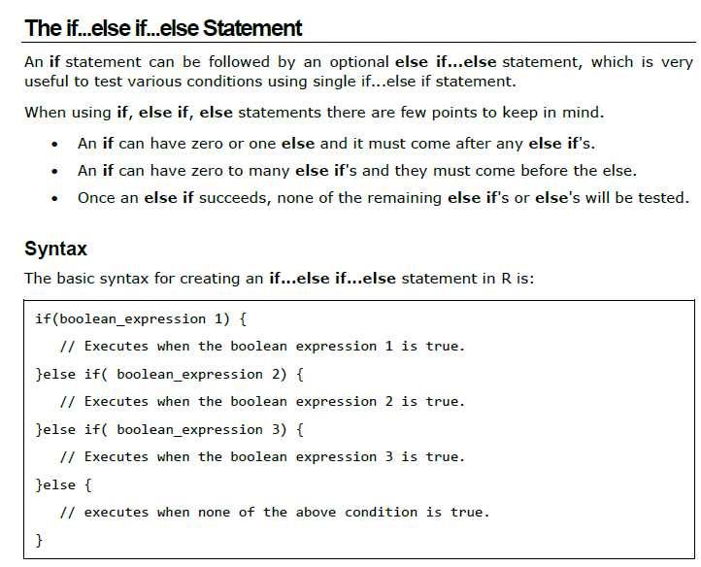

Slide 25
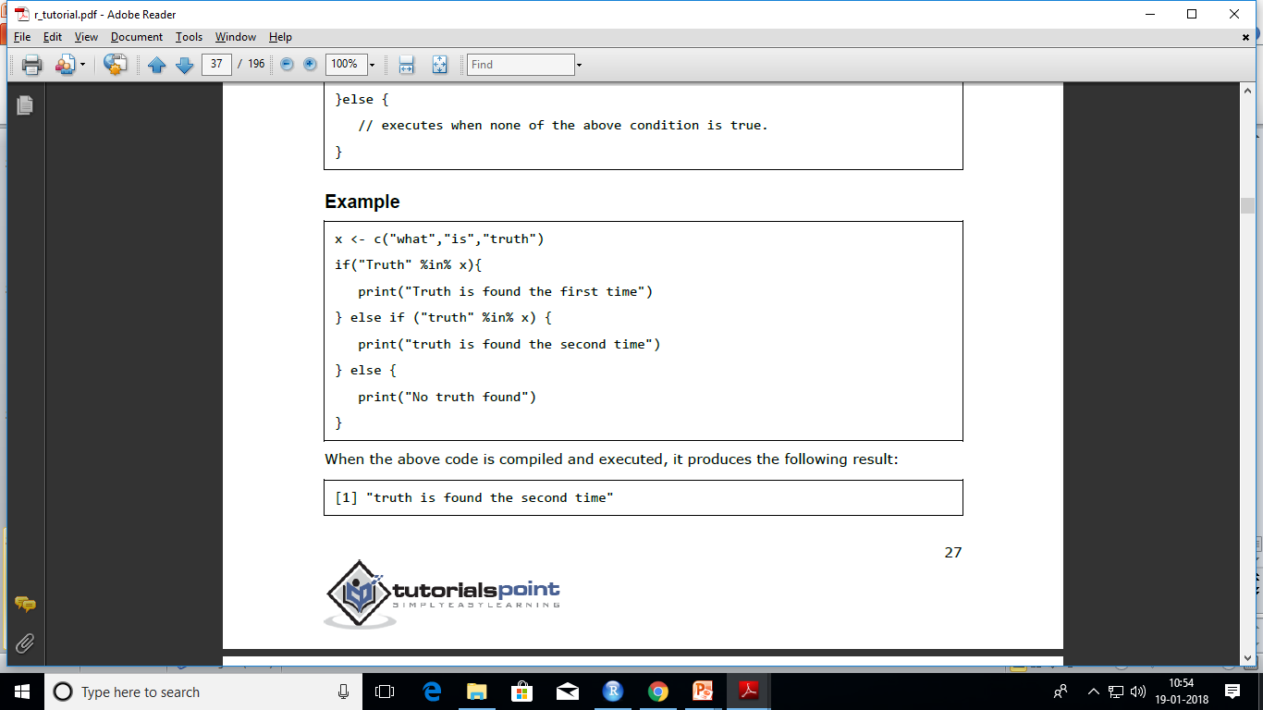

Slide 26
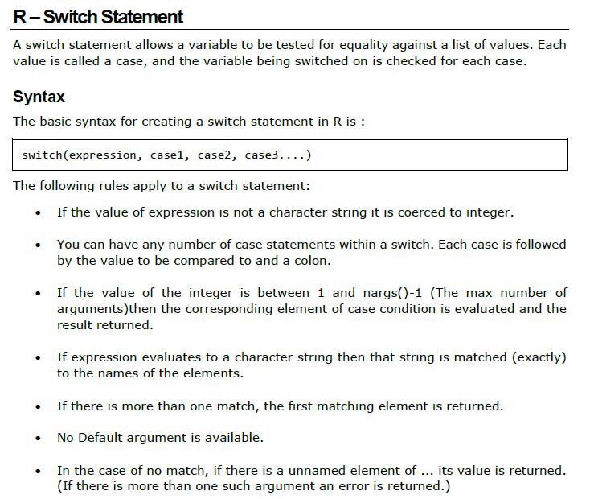

Slide 27
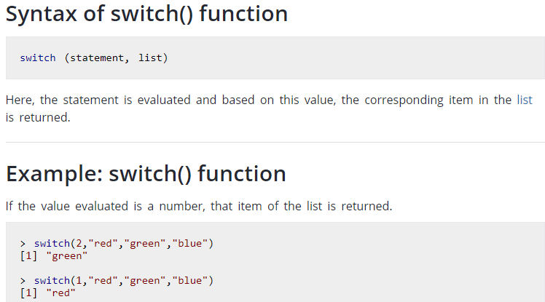
> switch(3.4,"red","yellow","white")
[1] "white"
> switch(2.1,"red","yellow","white")
[1] "yellow"
> switch(2.3,"red","yellow","white")
[1] "yellow"
> switch(2.9,"red","yellow","white")
[1] "yellow"

Slide 28
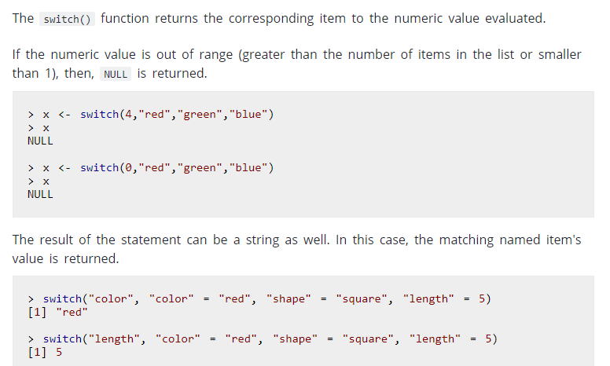

Slide 29
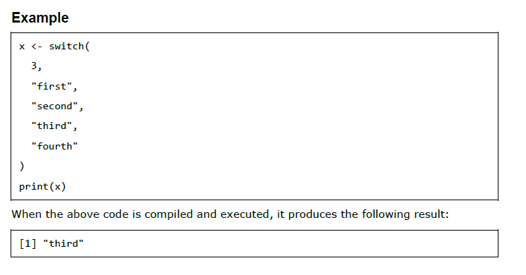

Slide 30
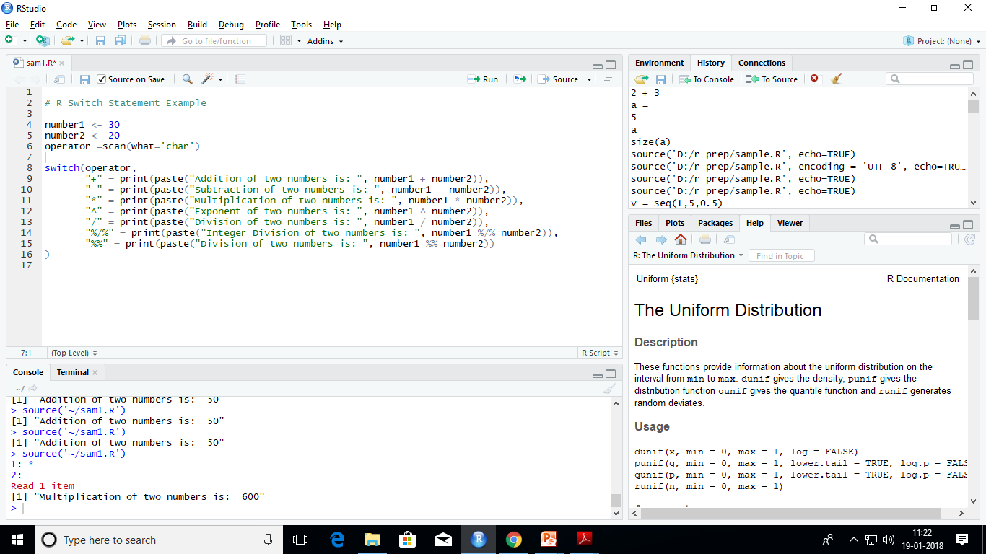

Slide 31
Loop statements
There may be a situation when you need to execute a block of code several number of times.
In general, statements are executed sequentially.
The first statement in a function is executed first, followed by the second, and so on.
Programming languages provide various control structures that allow for more complicated execution paths.

Slide 32
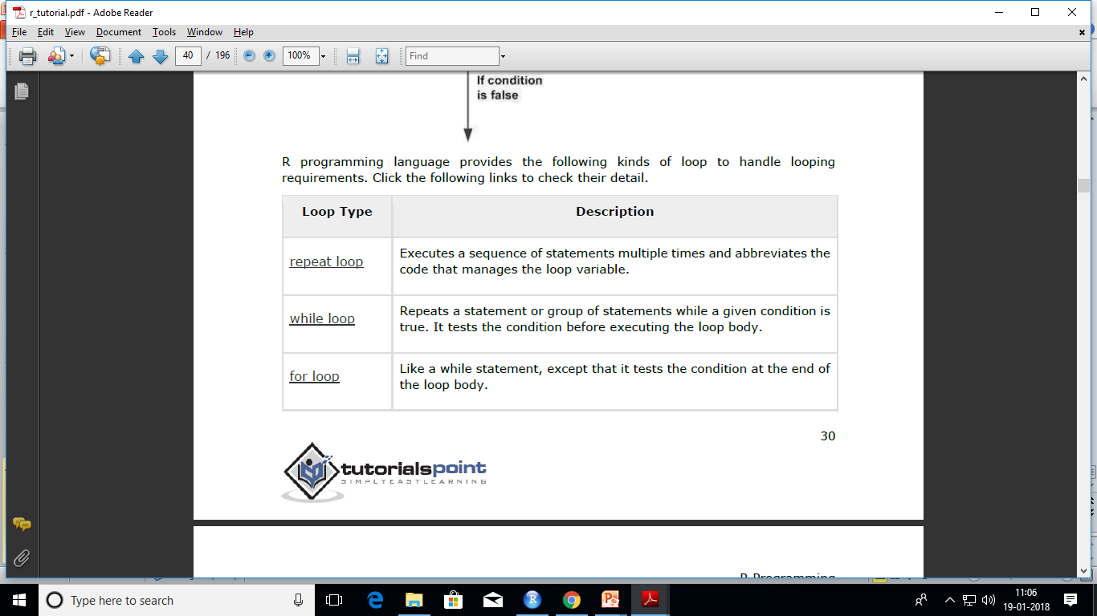

Slide 33
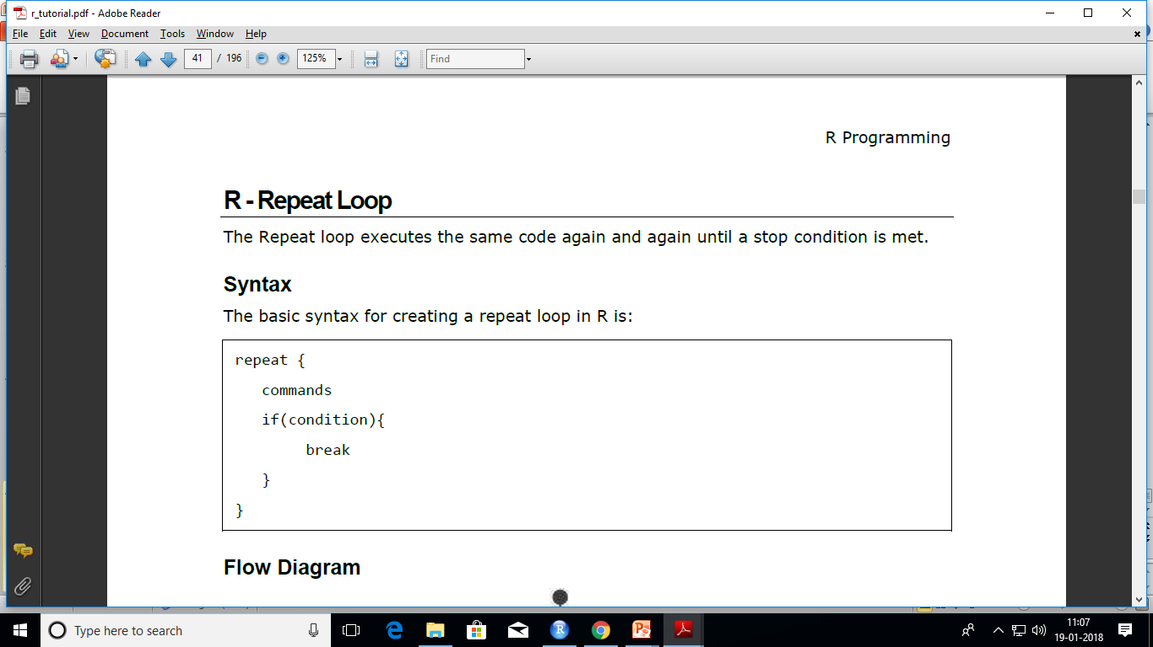

Slide 34
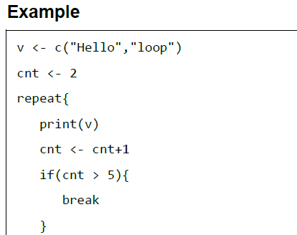
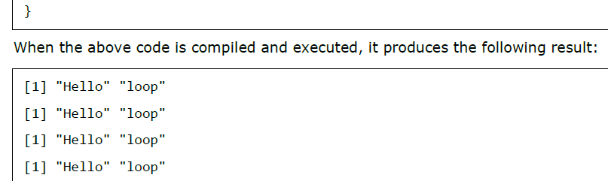

Slide 35
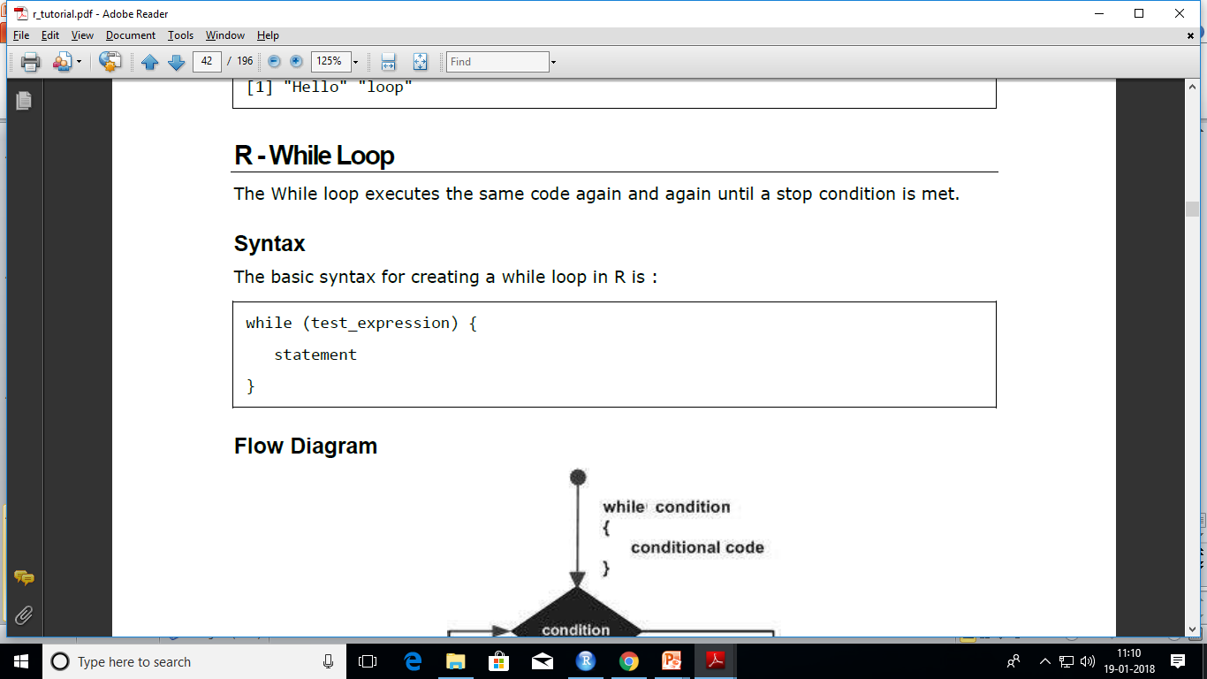

Slide 36
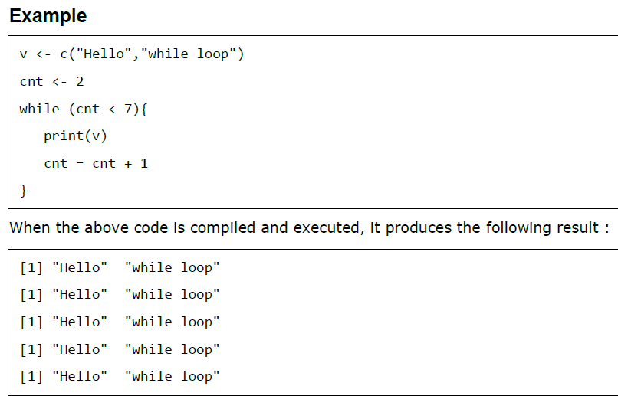

Slide 37
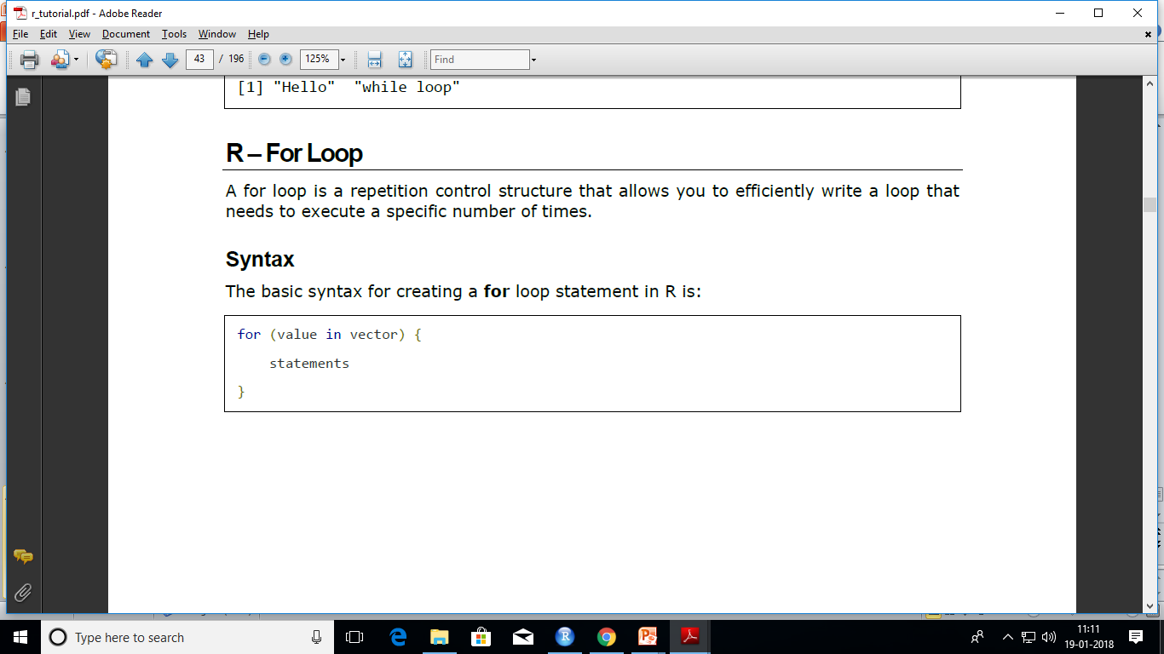

Slide 38
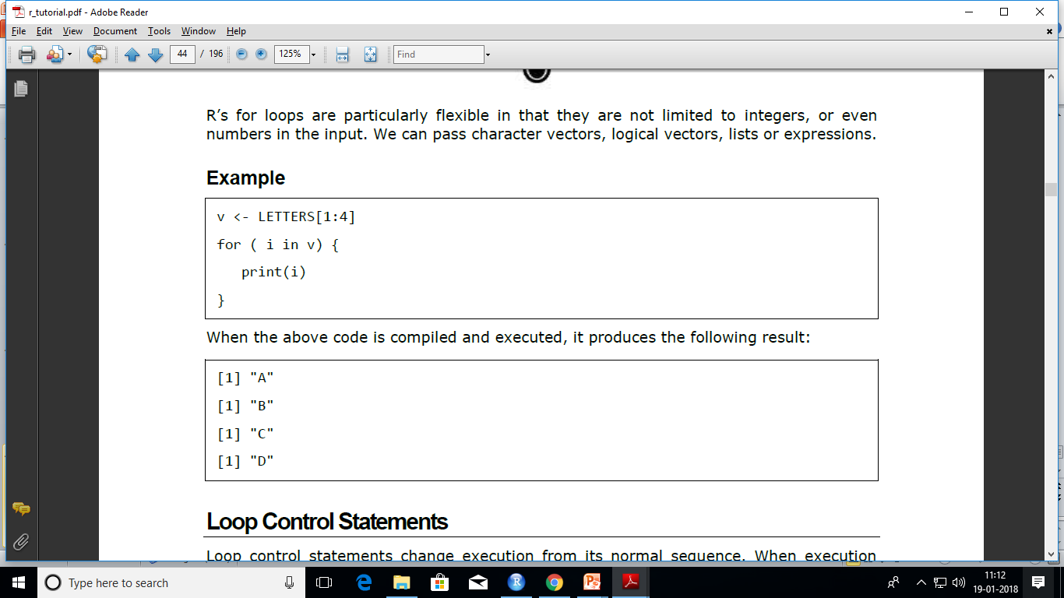

Slide 39
Sample programs
Print a pattern
Find whether prime or not
Generate Fibonacci series
Find factorial
…..

Slide 40
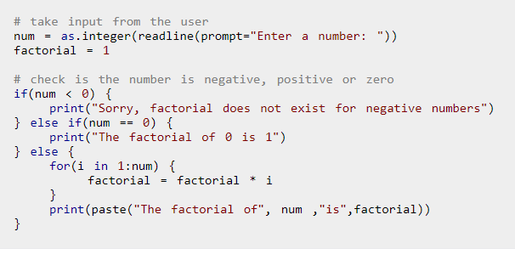
Factorial

Slide 41
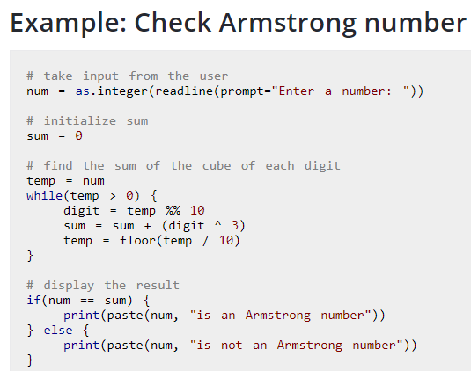

Slide 42
graphs
> pw = read.csv(file.choose()) //plots.csv
>Pw
boxplot(pw$Count, pw$Speed)
The stripe shows the median, the box represents the upper and lower hinges, and the whiskers show the maximum and minimum values.

